Slide 1
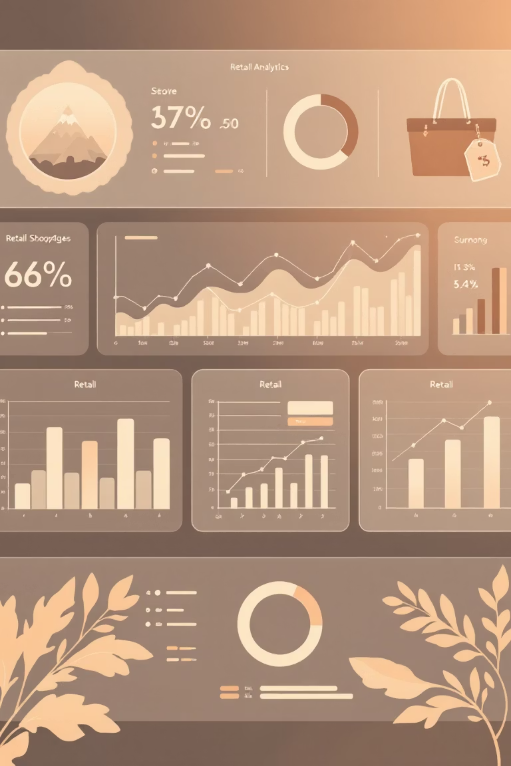
Customer Shopping Behavior Analysis
Uncovering insights from 3,900 purchases to drive data-driven business decisions

Slide 2

DATASET OVERVIEW
The Foundation
3,900
18
50
Total Purchases
Data Points
Locations
Transactions analyzed across all categories
Columns tracking customer behavior
Geographic diversity in customer base
25
Product Types
Items purchased across categories

Slide 3

DATA PREPARATION
Python Analysis Pipeline
01
Data Loading & Exploration
Imported dataset, inspected structure with pandas
02
Missing Data Handling
Imputed 37 missing review ratings using category medians
03
Feature Engineering
Created age groups and purchase frequency metrics
04
Database Integration
Loaded cleaned data into PostgreSQL for SQL analysis

Slide 4

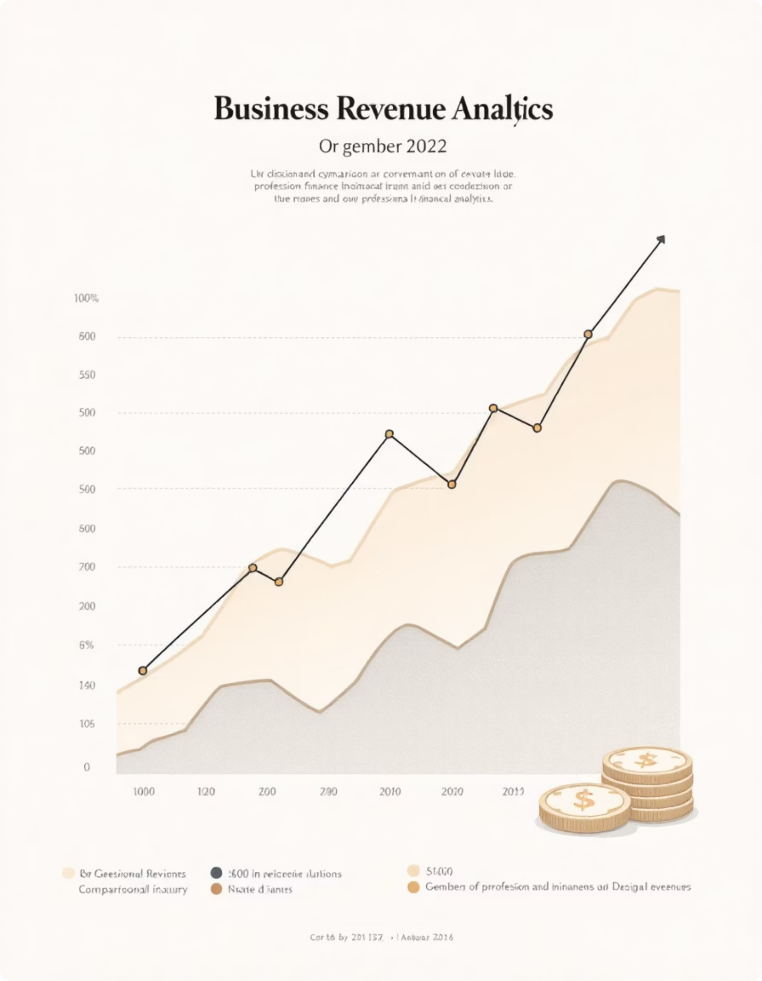
Revenue Insights
Gender Distribution
Average Spend
Male customers generate significantly higher revenue
Consistent across demographics
Male: $157,890 total revenue
$59.76 average purchase amount
Female: $75,191 total revenue
Male customers represent 52% of total base
3.75 average review rating

Slide 5

TOP PERFORMERS
Product Performance
1
2
3
Gloves
Sandals
Boots
Highest rated: 3.86 average
Strong performance: 3.84 average
Consistent quality: 3.82 average
4
5
Hat
Skirt
Popular choice: 3.80 average
Solid ratings: 3.78 average

Slide 6
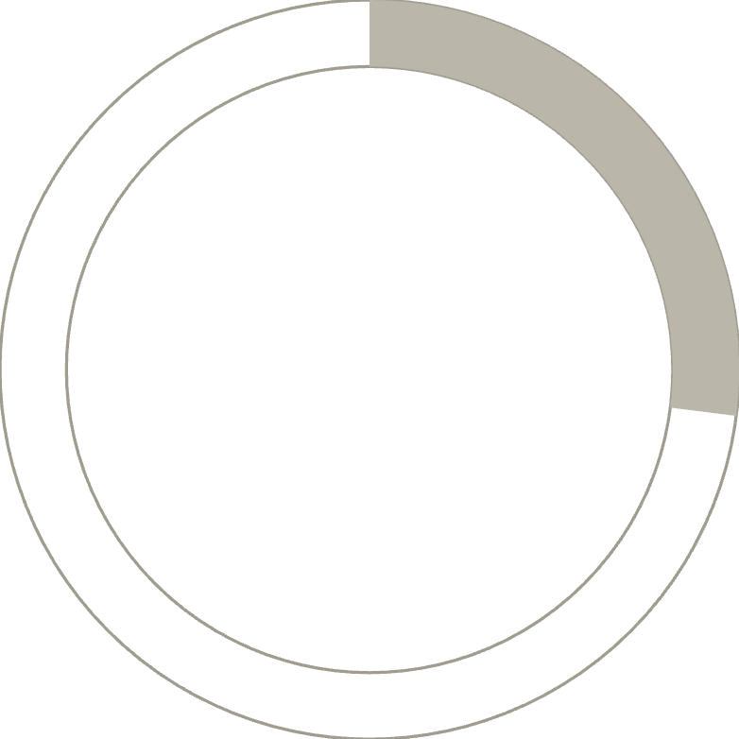

Subscription Analysis
27%
73%
Subscribers
Non-Subscribers
1,053 customers with active subscriptions
2,847 customers without subscriptions
Spending Patterns
Opportunity
Subscribers: $59.49 average
Large untapped potential in converting 73% non-subscribers
Non-subscribers: $59.87 average
Minimal spending difference

Slide 7
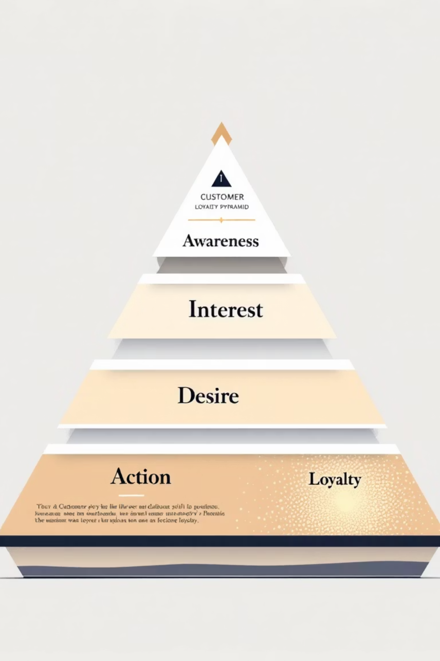
CUSTOMER SEGMENTS
Loyalty Distribution
Loyal Customers
Returning Buyers
3,116 customers
701 customers
80% of customer base
18% showing repeat behavior
New Customers
83 customers
2% first-time buyers
Strong loyalty foundation with 958 repeat buyers holding subscriptions

Slide 8
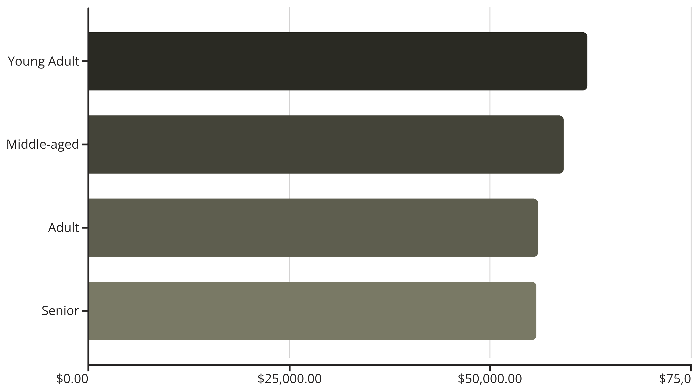
Revenue by Age Group
Young adults lead revenue generation, but all segments show balanced contribution

Slide 9

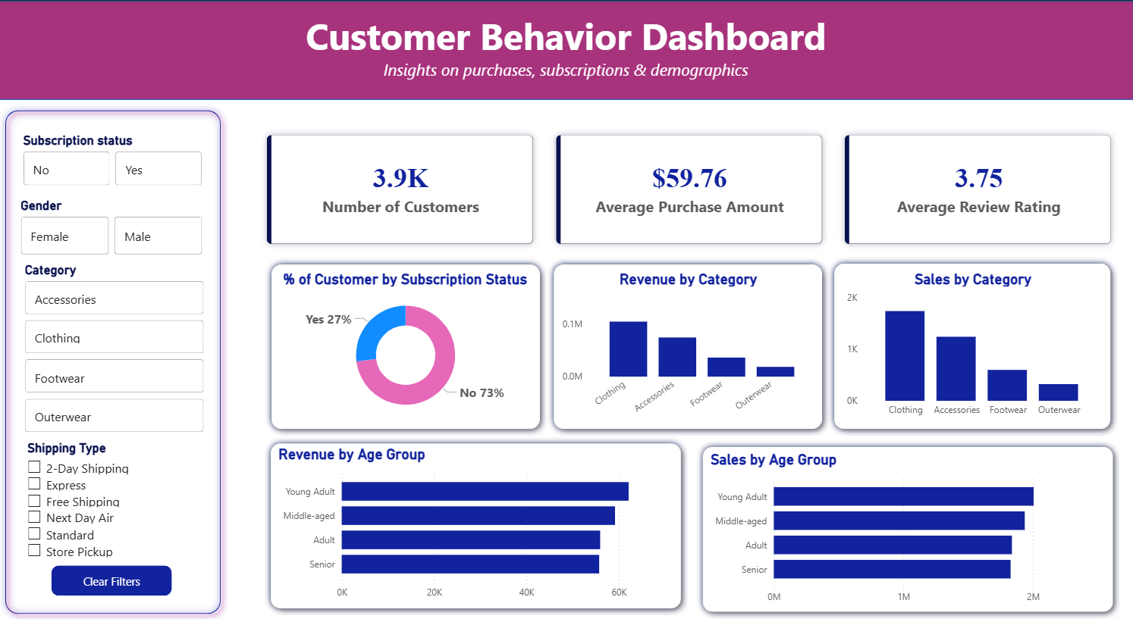

DASHBOARD
Interactive Analytics
Real-Time Insights
Category Performance
Demographics
Analyze age and subscription trends
Track customer behavior patterns
Monitor revenue by product type

Slide 10





ACTION ITEMS
Business Recommendations
Subscription Benefits
Loyalty Programs
Discount Strategy
Promote exclusive perks to convert 73% non-subscribers
Incentivize 958 repeat buyers with rewards
Balance promotions with profitability goals
Product Spotlight
Segment Focus
Highlight top-rated items like gloves and sandals
Target young adults and loyal customers for growth

